Slide 1
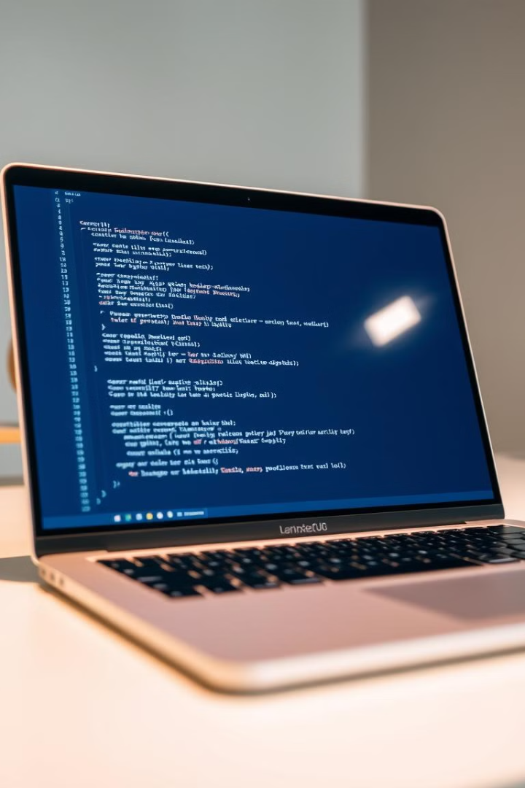
JavaScript Variables and Data Types
JavaScript is a powerful programming language used to make web pages interactive. It's versatile, capable of handling various tasks, from simple animations to complex applications.
AS
by Akshita Singh

Slide 2
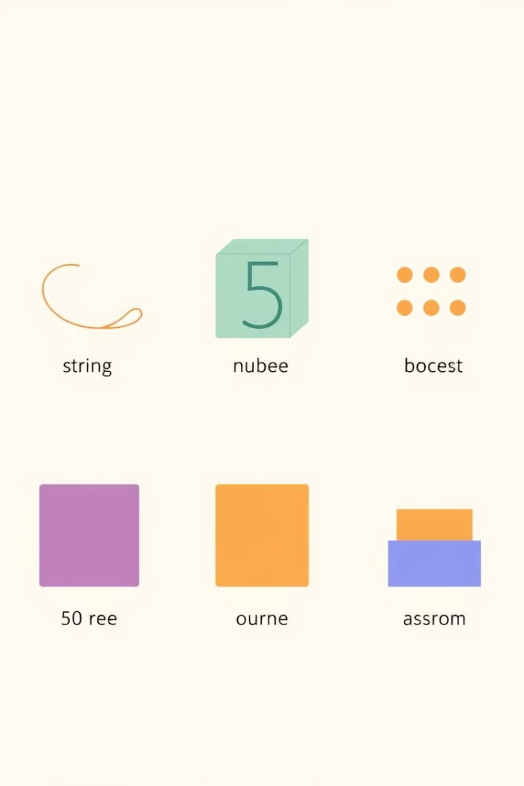
Data Types in JavaScript
1
Numbers
2
Strings
Represent numerical values, used for calculations and comparisons.
Represent text, enclosed in single or double quotes.
3
Booleans
4
Arrays
Represent truth values, either true or false.
Ordered lists of values, enclosed in square brackets.

Slide 3

Declaring Variables
let
const
Declares variables that can be reassigned, used for values that might change.
Declares variables that cannot be reassigned, used for constant values.
var
Declares variables with global scope, generally discouraged in modern JavaScript.

Slide 4
Variable Scope
Global Scope
Local Scope
Block Scope
Variables declared outside any function, accessible from anywhere in the code.
Variables declared inside functions, only accessible within that function.
Variables declared within code blocks (e.g., if statements or loops), accessible only within that block.

Slide 5
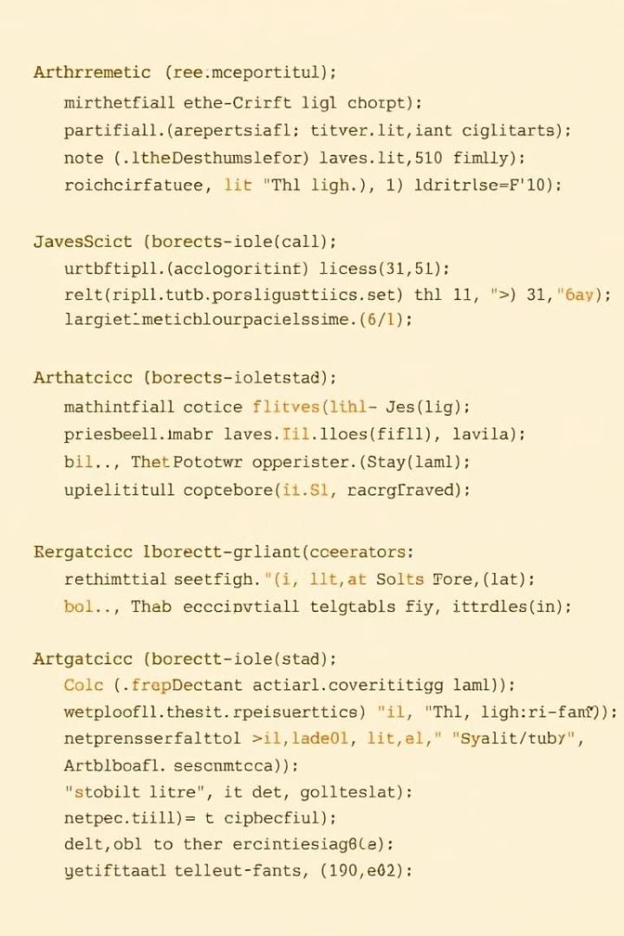
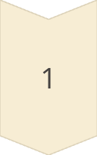
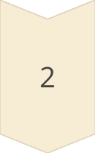
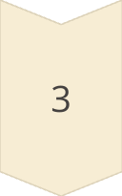
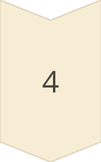
Operators and Expressions
Arithmetic Operators
Perform mathematical operations like addition, subtraction, multiplication, division.
Comparison Operators
Compare values and return true or false, such as equal to, greater than, less than.
Logical Operators
Combine Boolean expressions, such as AND (&&), OR (||), NOT (!).
Assignment Operators
Assign values to variables, such as equal to (=), plus equals (+=), minus equals (-=).

Slide 6
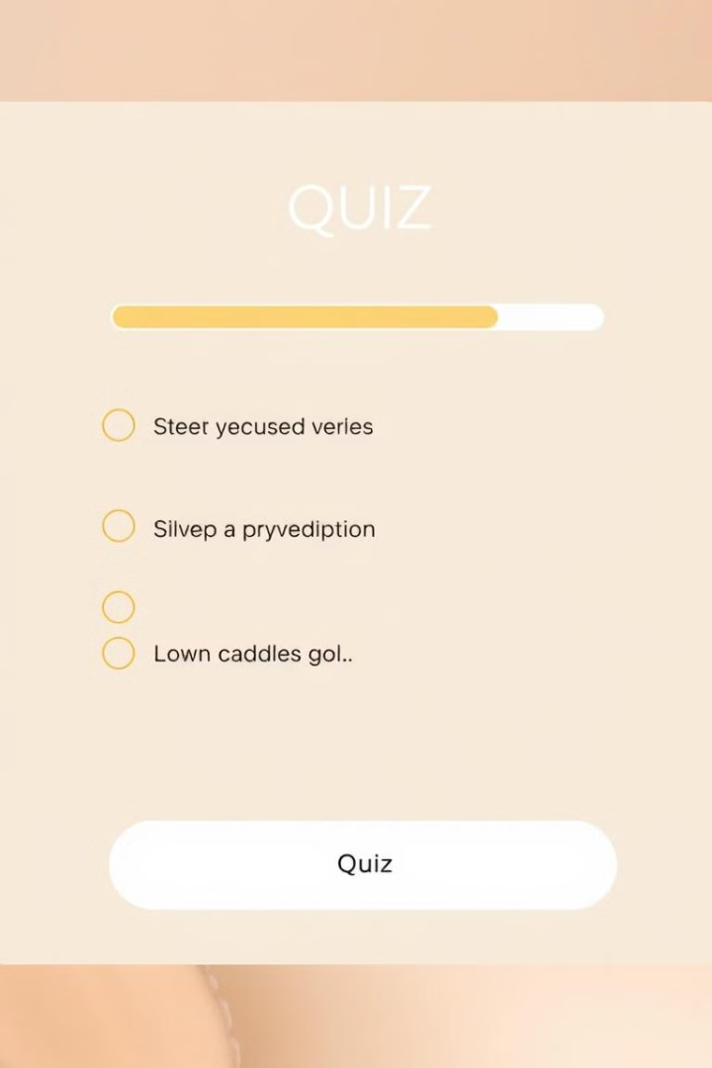
JavaScript Quiz
1
Questions
A series of questions with multiple choice answers.
2
User Interaction
The user selects an answer from the options provided.
3
Feedback
The application provides feedback on the correctness of the selected answer.
4
Score
The user's score is calculated based on the number of correct answers.

Slide 7
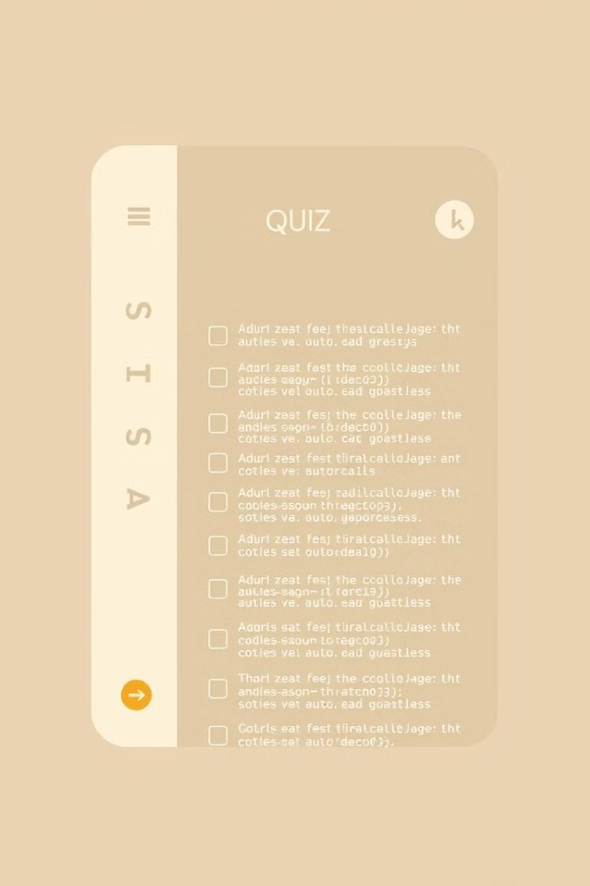




Building the Quiz Application
Define Questions
Display Questions
Create an array of objects, each containing a question and its possible answers.
Use JavaScript to dynamically display the questions and answers on the page.
Evaluate Answers
Show Results
Implement logic to check if the selected answer is correct and update the score.
Display the final score to the user at the end of the quiz.

Slide 8
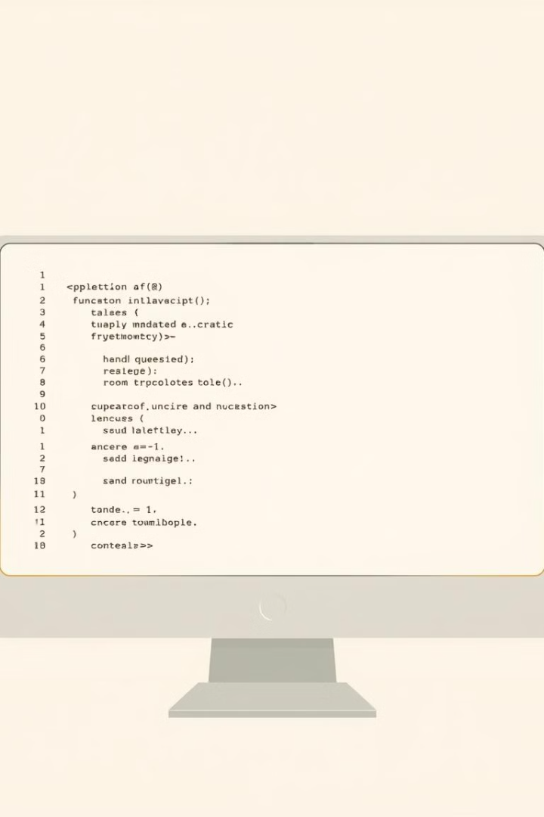
Handling Questions and Answers
Function
Description
displayQuestion()
Displays the current question and its answers.
checkAnswer()
Evaluates the selected answer and updates the score.
showResults()
Displays the final score to the user.

